Slide 1
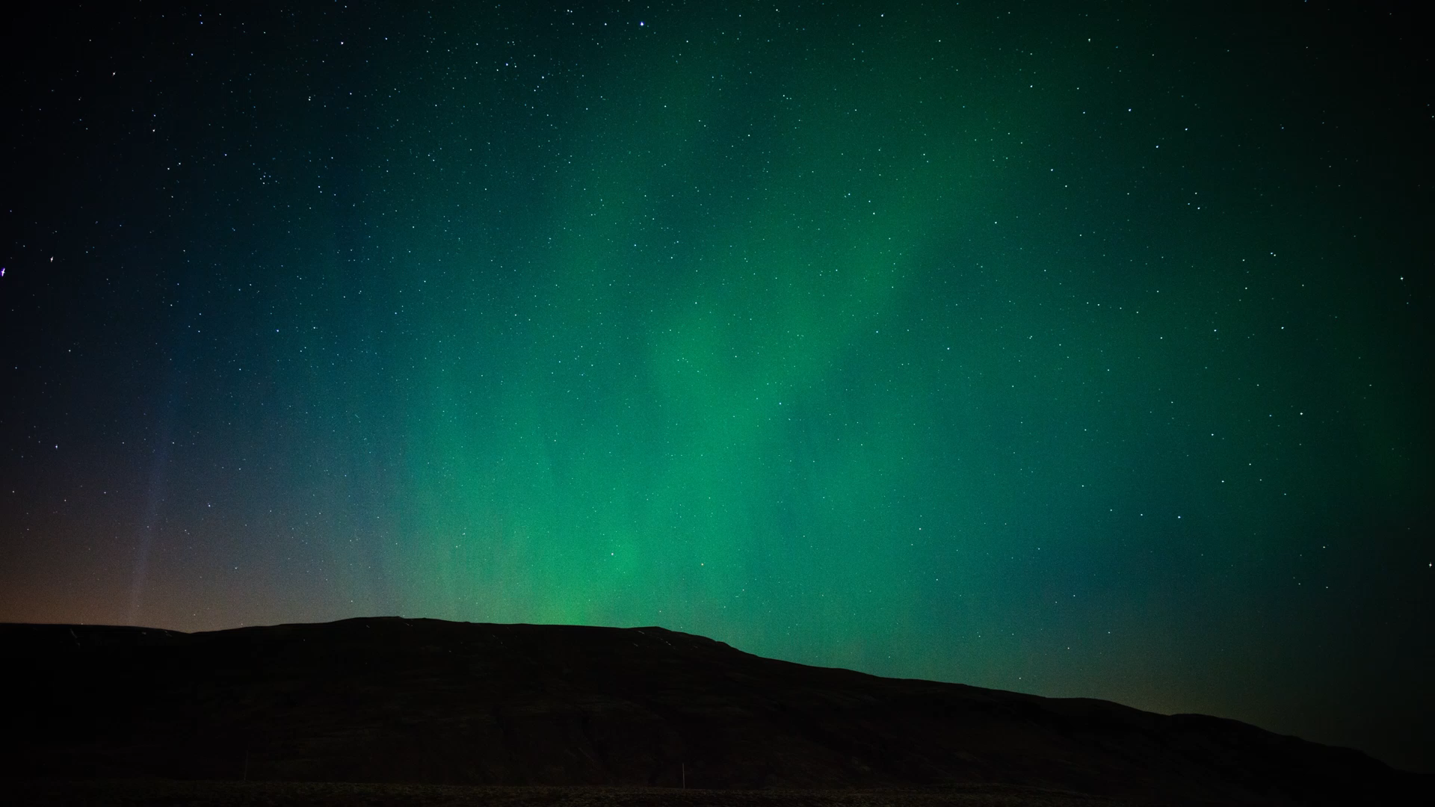


Investigating the Performance of a Semi-Professional Magnetometer for Space Weather Research: 13 Years of Measurements from a Backyard in Anchorage
Hunter Barndt
Advisor: Doğacan S. Öztürk
University of Alaska Fairbanks, Geophysical Institute, Space Weather Underground (SWUG)
whbarndt@alaska.edu

Slide 2
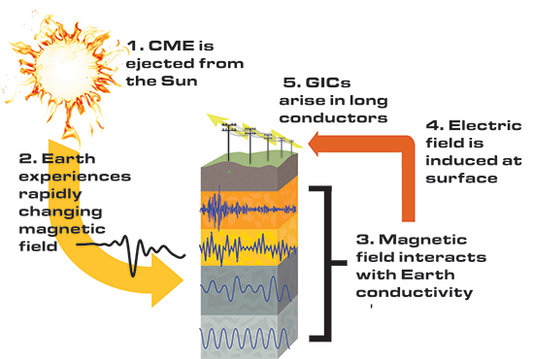
Background and Motivation
Space weather events are important to study in Alaska since they can cause geomagnetically induced currents (GICs)
These GICs can potentially produce power outages and pipeline corrosion
One way to predict them is by understanding how the magnetic field changes
Gannon, EEonline, 2016
Notes:
Transition: So, for some background and motivation, space weather events…

Slide 3
Space Weather UnderGround (SWUG)
The SWUG Program was founded by Charles Smith at the University of New Hampshire
SWUG aims to increase these measurements of geomagnetic disturbances by deploying low-cost arrays of magnetometers by partnering with schools across the states
Notes:
Transition: The Space Weather UnderGround or SWUG program, founded….

Slide 4
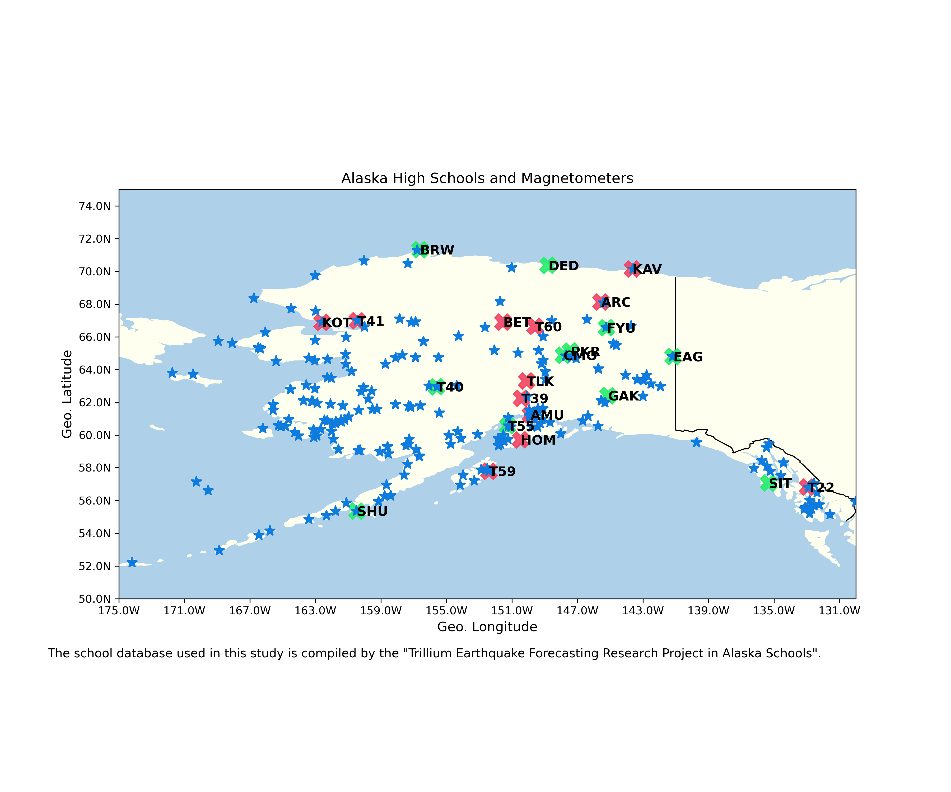
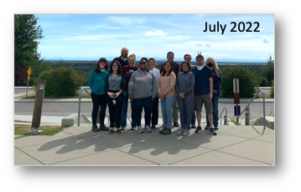
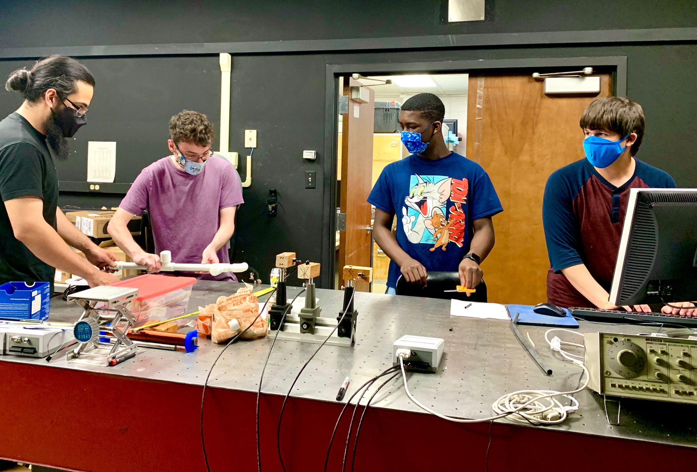
SWUG
UAF SWUG Programs:
Educator Development Program:
The educator development program allows educators to start their own satellite-SWUG programs at their schools
High School Student Program:
High school students build and deploy magnetometers as a part of their science club activities
Educator Development Program High School Student Program
Notes:
Transition: UAF has a few of their own SWUG programs. We have an Educator…

Slide 5
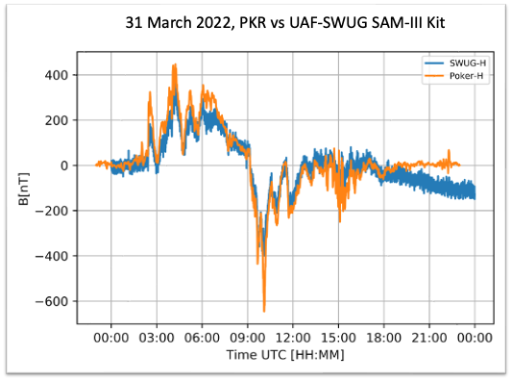
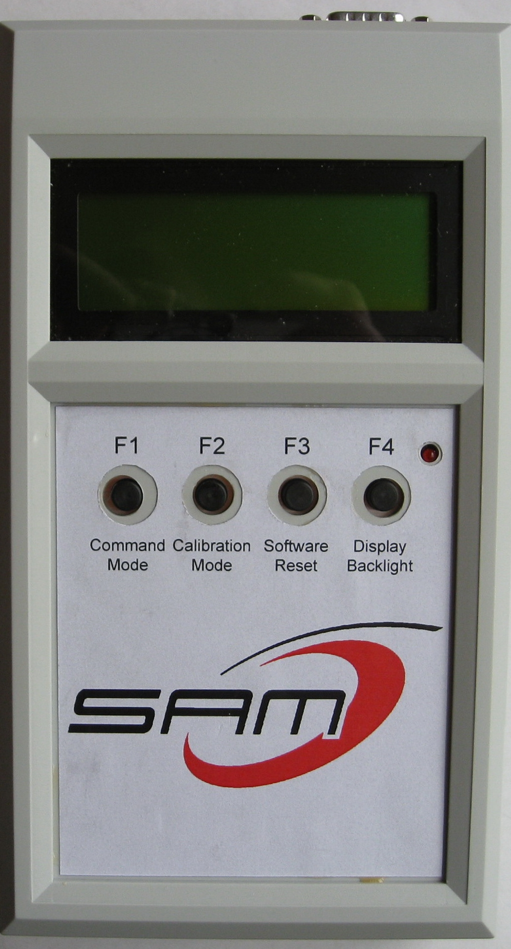
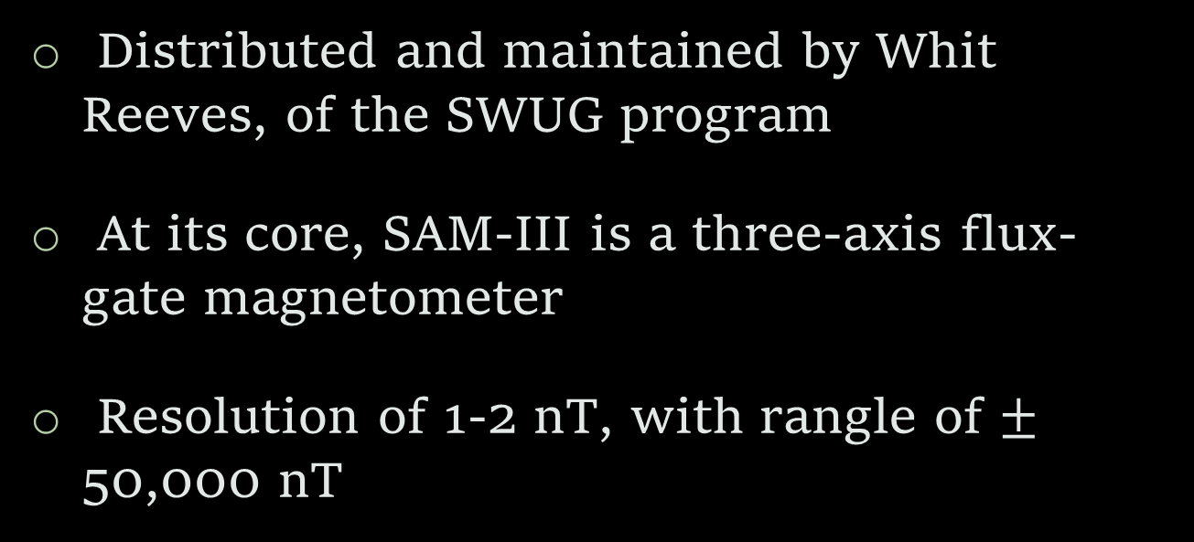
Simple Aurora Monitor (SAM-III)📏
Distributed and maintained by Whit Reeves, of the SWUG program
At its core, SAM-III is a three-axis flux-gate magnetometer
Resolution of 1-2 nT, with rangle of $±$ 50,000 nT
Notes:
Transition: These low-cost magnetometers that are used in the SWUG program are called…

Slide 6
Introduction 📖
Whit Reeves curated 13 years of SAM-III magnetometer data (thank you), lots of potential…
Measurements taken: May 2009 – Present Day
Data Provided:
Magnetic ‘N’, ‘E’, ‘Z’: x, y, z respectively
Temporal Resolution: 10 seconds
Location: Anchorage, Alaska
Notes:
Transition: So, with that said, my project is about investigating the performance of one of these SAM-III magnetometers

Slide 7
Goals🏁
Data preparation:
Data Cleaning
Handle Missing/Erroneous Data
Investigate the capabilities and dependencies of the SAM-III magnetometer scientifically and operationally
Compare with science-grade magnetometer measurements
Notes:
Transition: So the goals with this large dataset would be to first prepare the data…
One way to investigate… compare..

Slide 8



First Step: Tools🧰
Data parsing, manipulation and analyzing were all done using:
Python PL
Pandas Library
Thanks to my crew…
Image via Midjourney V5
Notes:
Transition: The first step with pursuing these goals was to first choose what tools we will be using

Slide 9
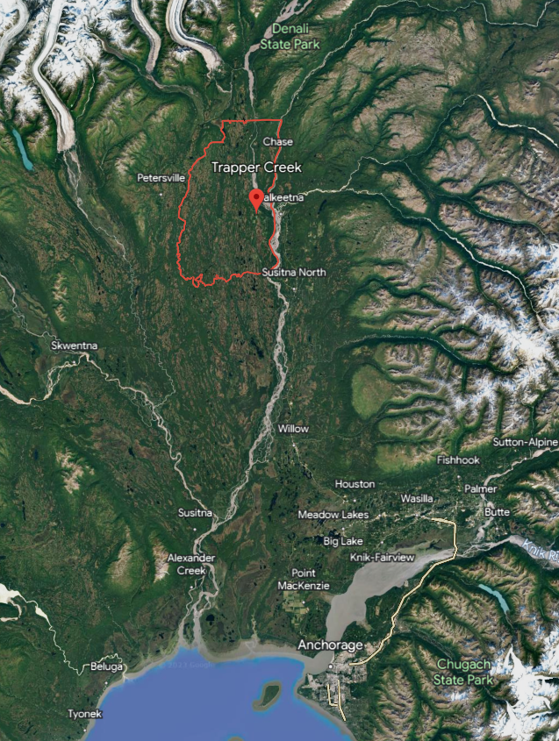
Lots of Data!
Reeves Anchorage SAM-III Data:
2010 – 2022, ~2Gb
GIMA Data (Trapper Creek):
2010 – 2022, ~20Gb
Roughly 75 miles apart but similar in magnetic latitude and longitude
Enough data to overlap completely, sweet…
Notes:
Transition: And I needed that help because there was a lot of data to analyze. We chose to investigate from 2010 to 2022 with at roughly 2Gb of data in size.

Slide 10
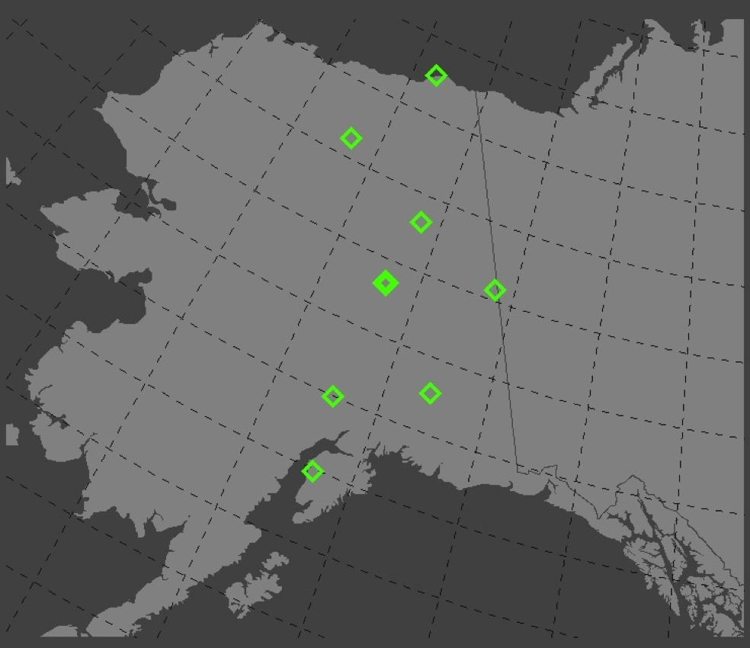
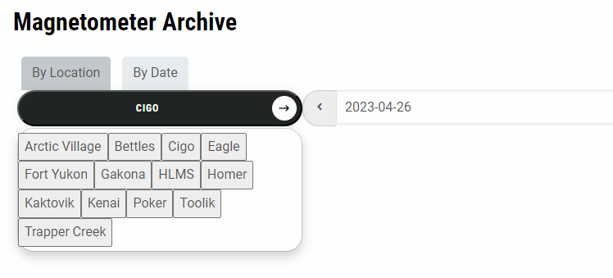
Geophysical Institute Magnetometer Array (GIMA)
Website: https://www.gi.alaska.edu/monitors/magnetometer
Median of the day is subtracted before
Data provided:
Magnetic ‘H’, ‘D’, ‘Z’: x, y, z respectively
Temporal Resolution: 1 second
Notes:
Transition: And this is where I received my GIMA data..

Slide 11
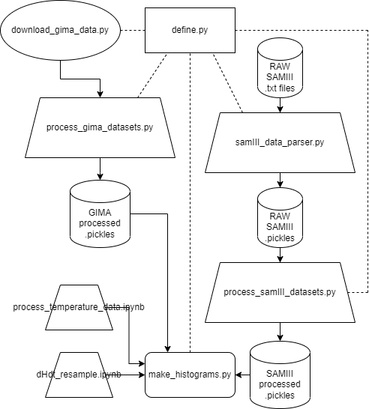
Architecture Diagram
900+ lines of code
Which can hopefully be used for future SWUG and SAM-III magnetometer data parsing and analysis
Notes:
Transition: With all of the tools that I would be creating for this project, I wanted to….

Slide 12
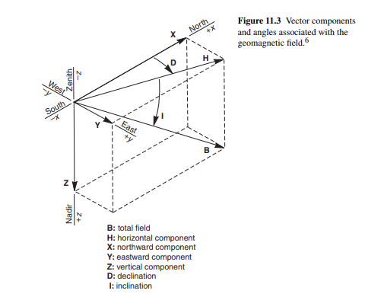
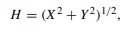
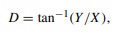
Coordinates!
Notes:
Transition: With regards to coordinate systems, both SAMIII and GIMA measure x,y, and z components. In this analysis, we decided to convert x and y to this H component. This component helps encapsulate the horizontal components of the magnetic field into one since most geomagnetic activity is

Slide 13
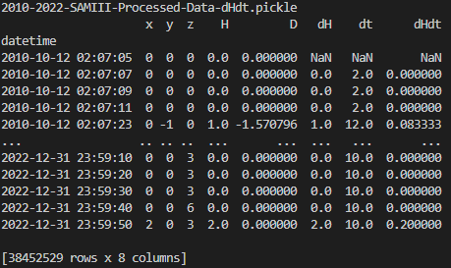
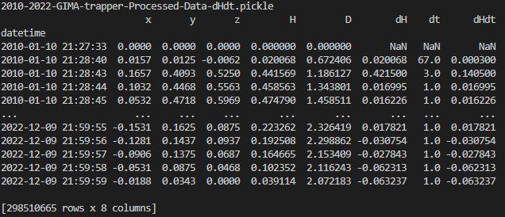
Processed Datasets
SAM-III:
GIMA:
1. Subtracted the start of each day for each day
2. Calculated H, D, dH, dt, and dH/dt
Notes:
Transition: So after parsing and organizing the data we have these processed datasets..
Each row is a measurement with its corresponding value
GIMA data has an order of magnitude many measurements

Slide 14
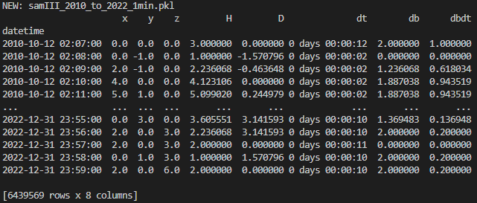
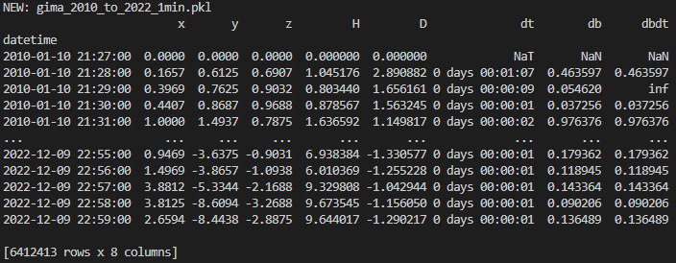
Resampled/Cleaned Datasets
SAM-III:
GIMA:
NaN values in resampled dataset:
SAMIII - 1.5%
GIMA - 22%
Notes:
Transition: These are the resampled datasets, just showing that for ease of analysis we resampled and cleaned the NaN values from the data before
GIMA - 1449380 NaN values
SAMIII – 9935 NaN values
GIMA – 89443 INF values
SAMIII – 110 INF values

Slide 15
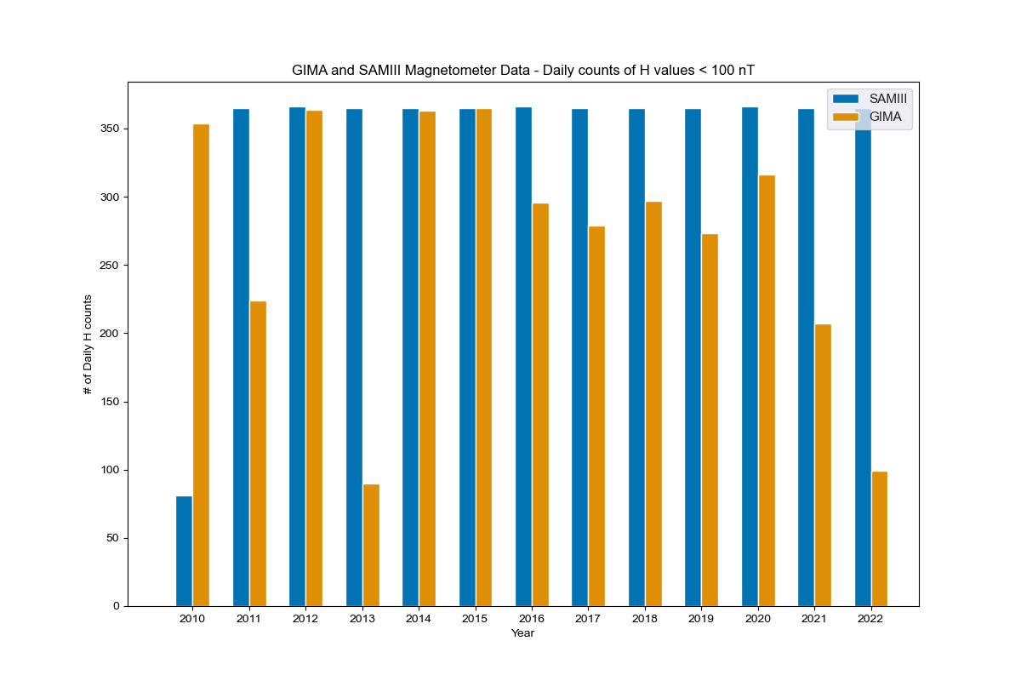
Results: Quiet Day counts
A look at the quiet data (H < 100nT) for each dataset – seem comparable

Slide 16
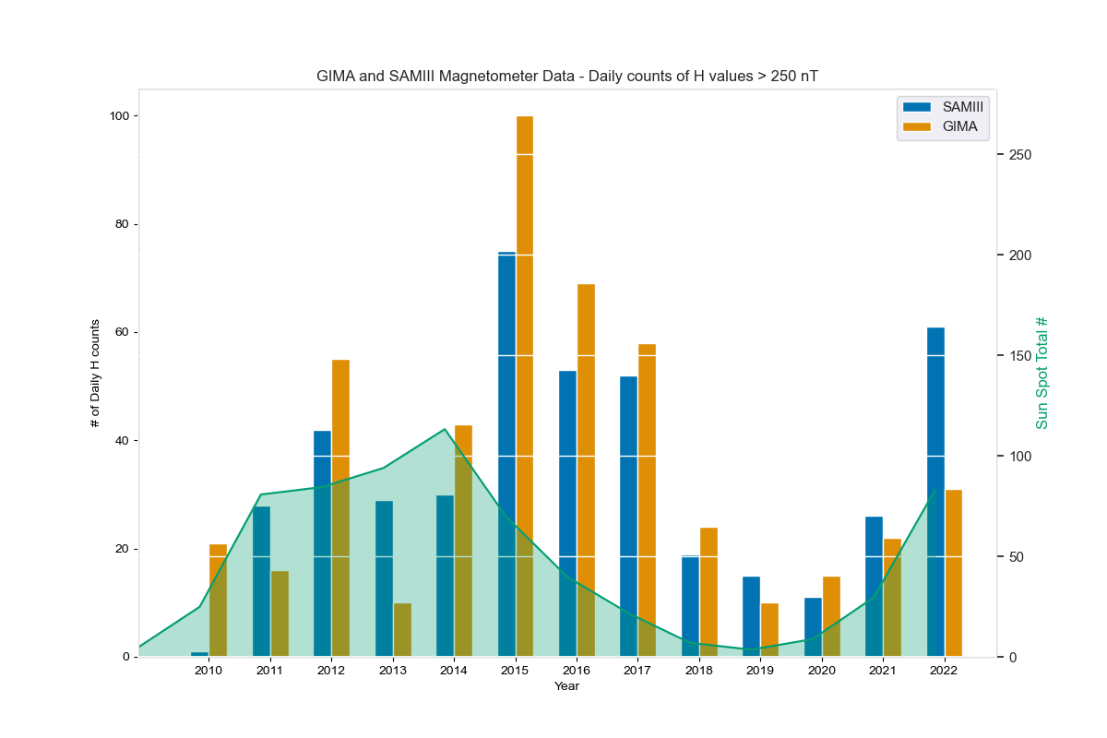
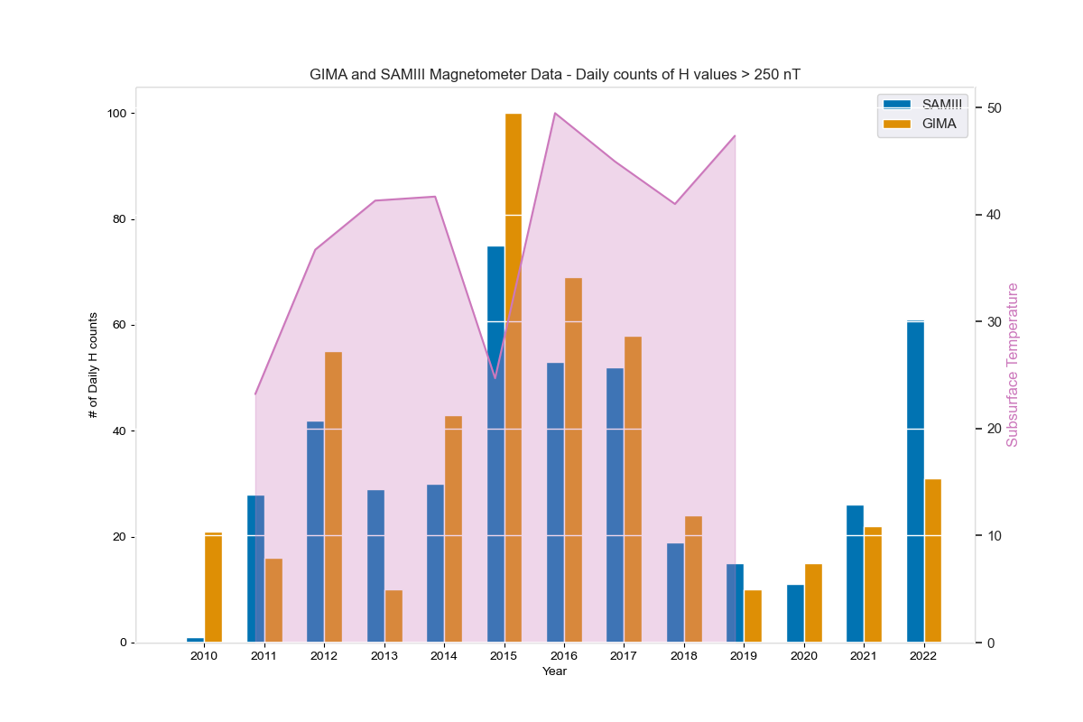
Histogram – Day counts of H > 250nT:
Comparted with Total Yearly Sunspots
Compared with Subsurface Temperature in E.R
Notes:
Transition: Now with this processed data, we can start with some analyses. These are the two primary ways we analyzed the data.
Left Plot:
All three axis first
This is our scientific analysis which compares geomagnetic activity to solar activity and the solar cycle.
Right Plot:
On the right you can see - With this analysis, we wanted to see if there were any dependencies with the readings based on temperature variation. In this case, there doesn’t seem to be one and we would want to look at smaller time scales like days to get a better understanding

Slide 17
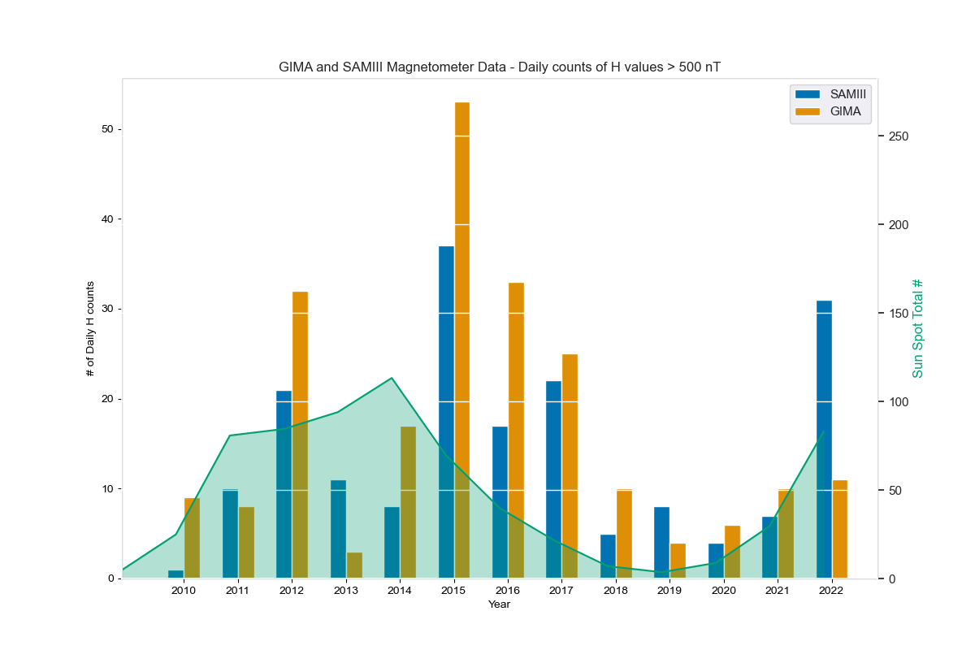
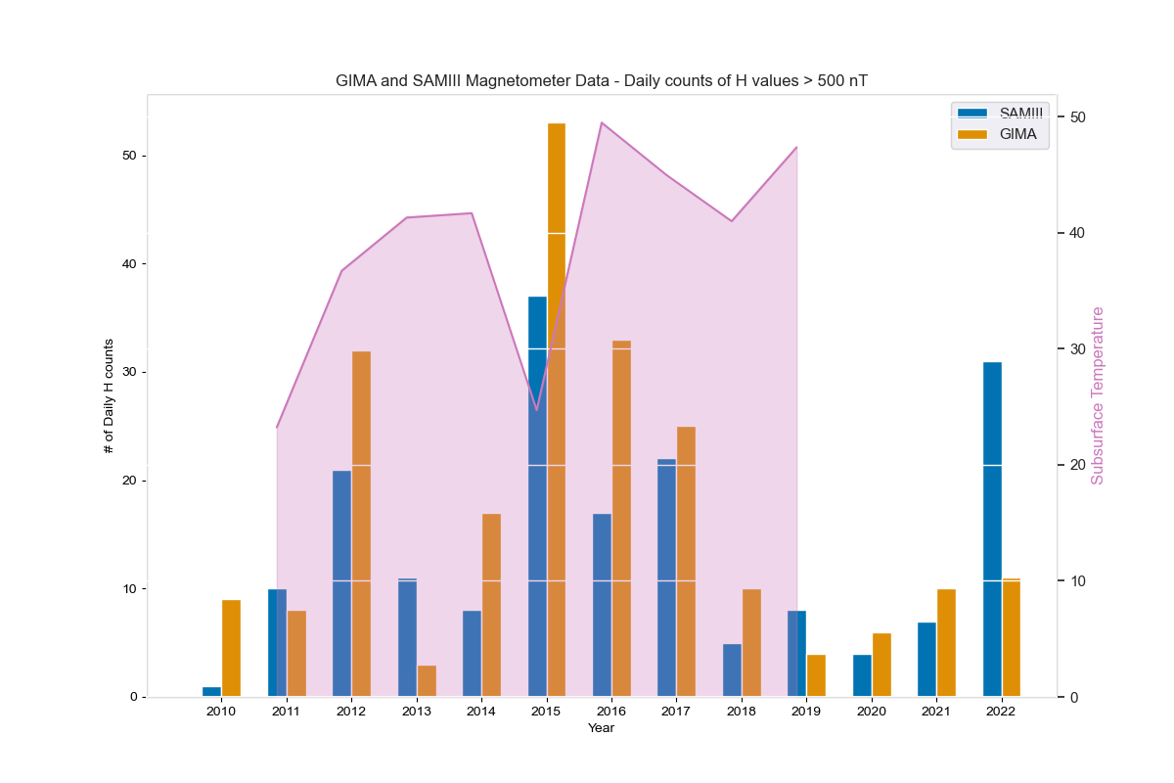
Histogram – Day counts of H > 500nT:
Comparted with Total Yearly Sunspots
Compared with Subsurface Temperature in E.R
Notes:
Both 250, 500 solar cycle dependence

Slide 18
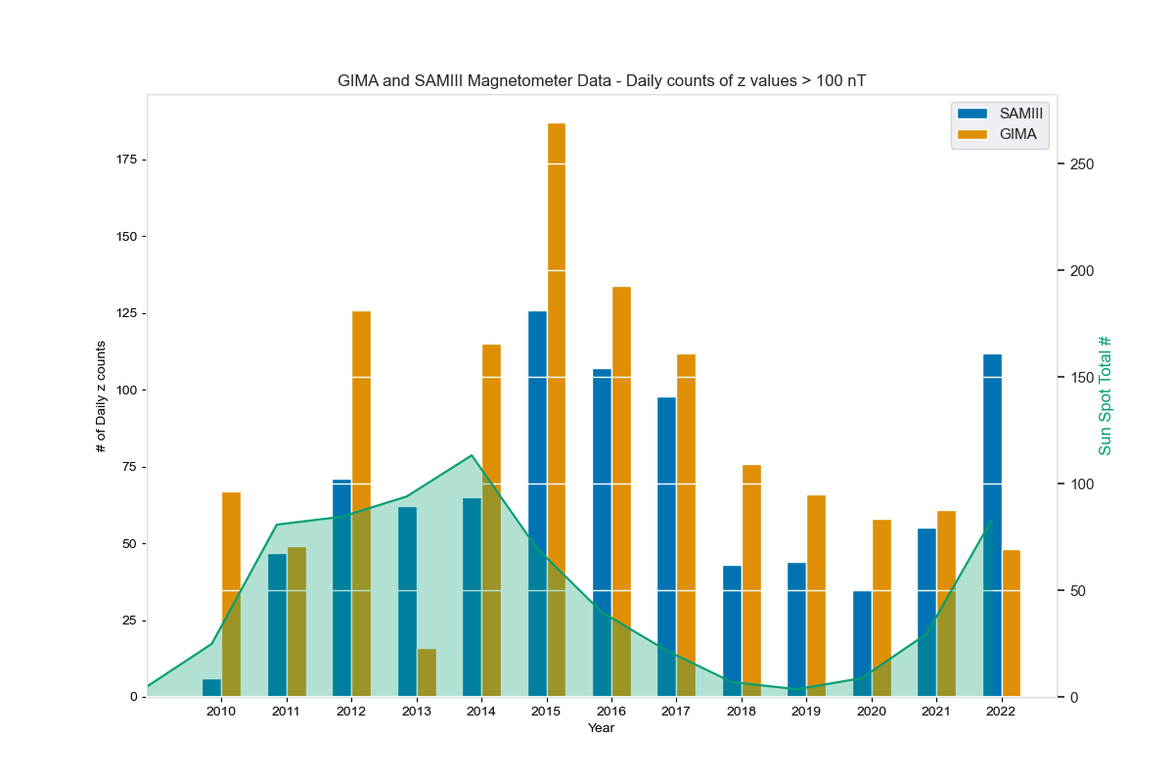
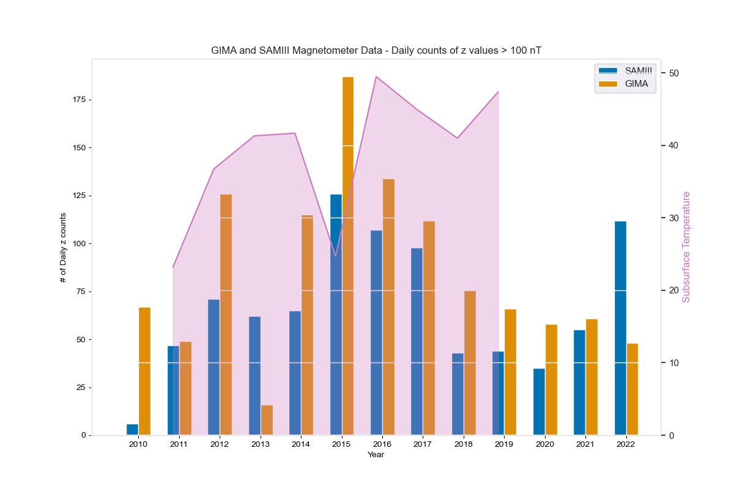
Histogram – Day counts of z > 100nT:
Comparted with Total Yearly Sunspots
Compared with Subsurface Temperature in E.R
Notes:
More responses in H than z but still shows dependence.

Slide 19
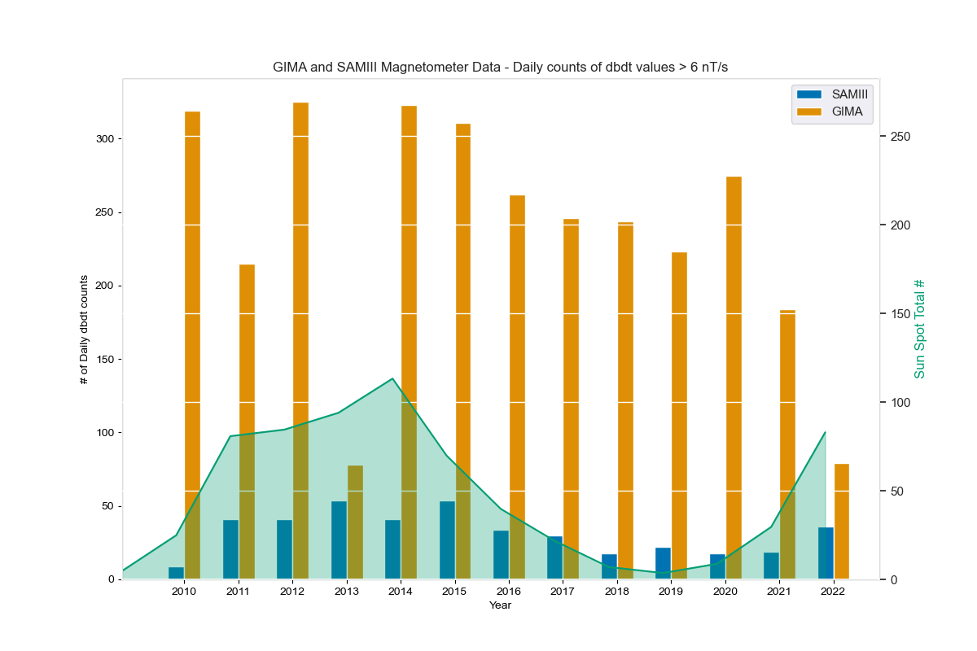
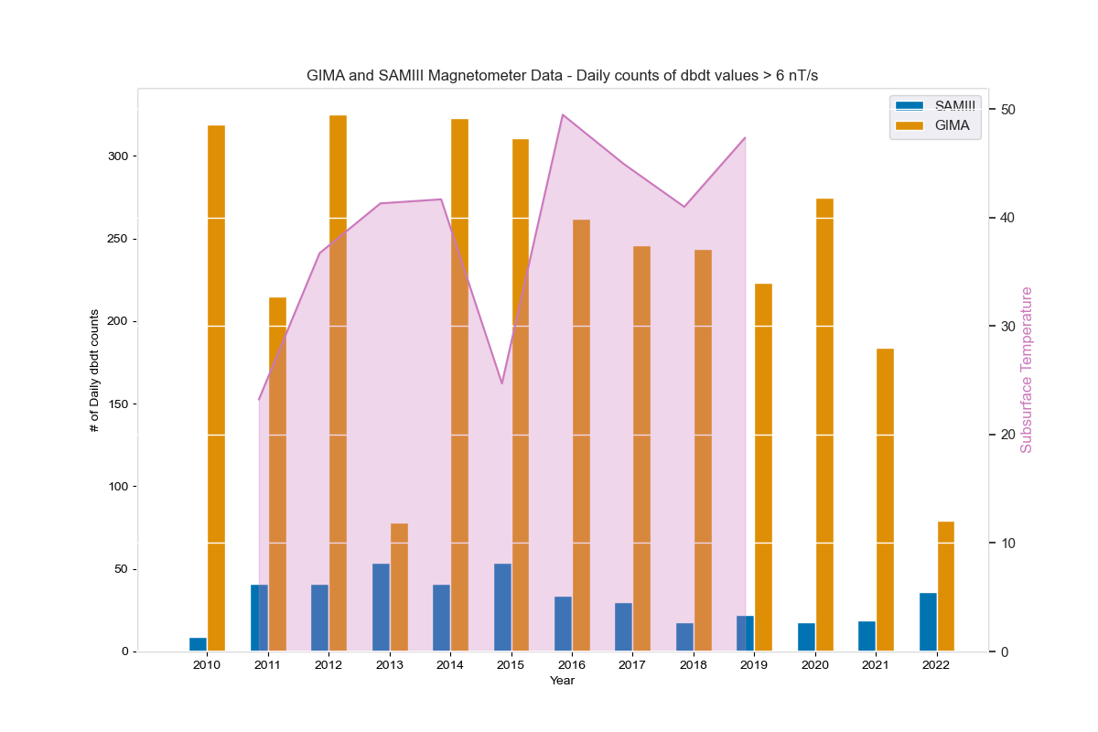
Histogram – Day counts of dH/dt > 6nT/s
Comparted with Total Yearly Sunspots
Compared with Subsurface Temperature in E.R
Notes:
Transition: With dH/dt, you can see some similarities however GIMA has orders of magnitude more readings that SAMIII. This seems to be due to the time resolution of both magnetometers

Slide 20
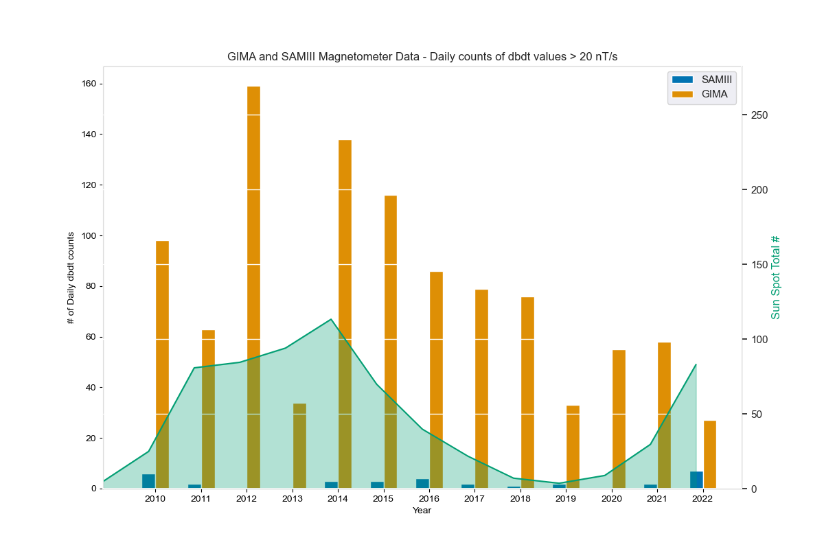
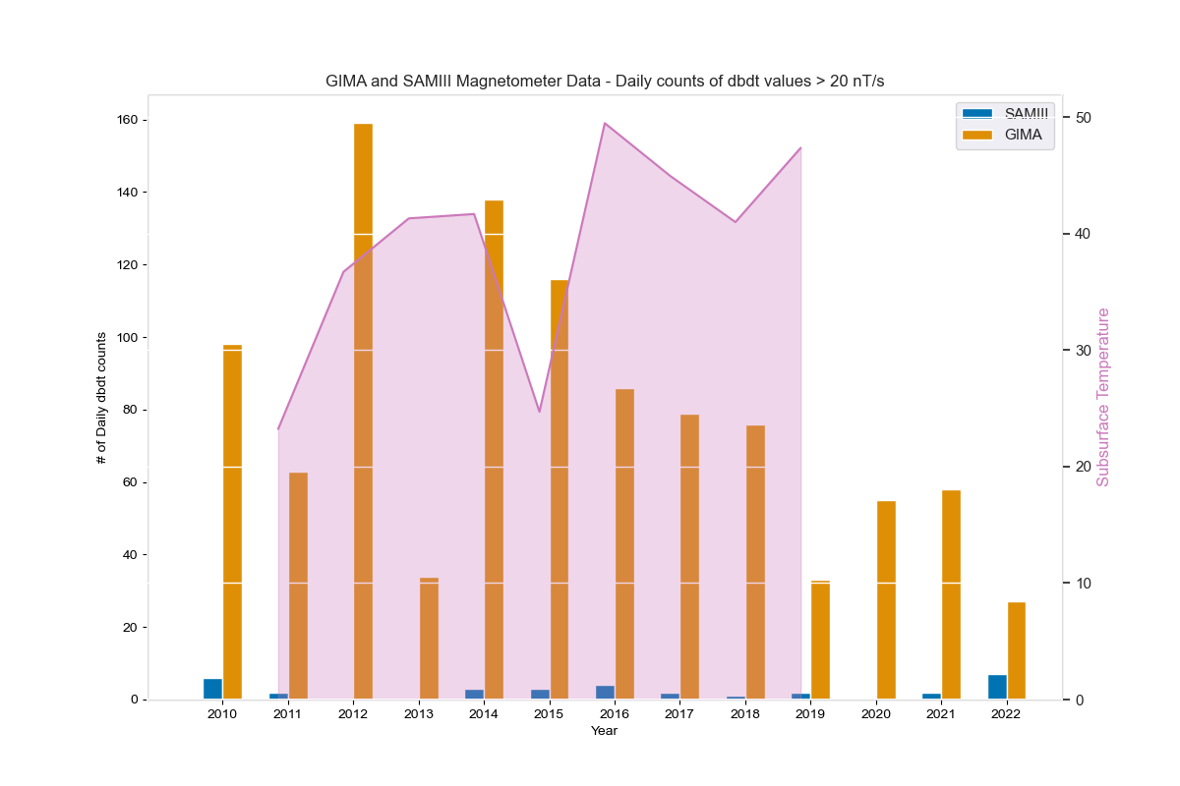
Histogram – Day counts of dH/dt > 20nT/s
Comparted with Total Yearly Sunspots
Compared with Subsurface Temperature in E.R

Slide 21
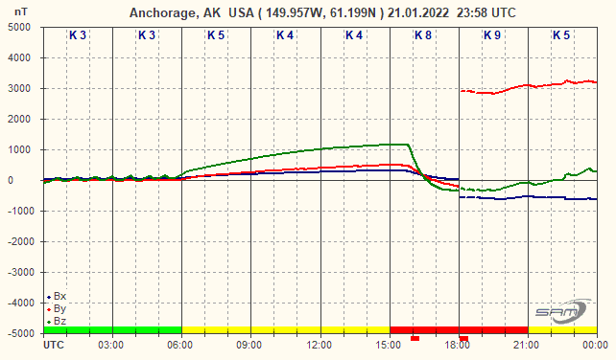
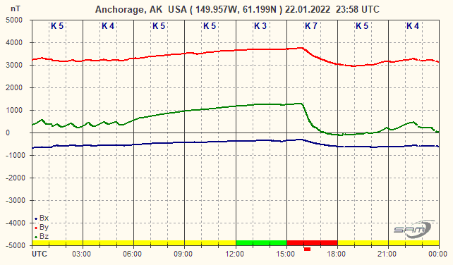
Observed Anomalies:
January 21st-22nd 2022:
Few Known Data Anomalies:
Notes:
2010 – Not enough SAM-III data
2013 – Not enough GIMA data
2011, 2019, 2021 – More SAM-III readings?
2022 – Anomalous SAMIII data
Takeaway from graphs - Look at more granule temperature data, temperature senor is necessary to establish temperature variation of data and discontinuity

Slide 22
Takeaways:
January 21st-22nd 2022:
dB/dt calculations are greatly effected by SAMIII’s temporal resolution
Yearly averaged Subsurface temperature is too coarse to find correlations but daily temperature variation is a significant factor ->
Next iterations of SWUG deployments will carry temperature sensors and 1 second resolution

Slide 23
Questions?
Reach out for any more questions!!: whbarndt@alaska.edu

